Slide 1

Installing Python
MTH 564 – Mathematical Modeling

Slide 2


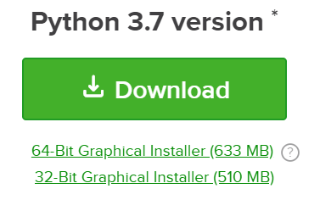
Installation of Python
Installation of Python
1. Go to the Anaconda download website:
https://www.anaconda.com/download/
2. Select your Operating System:
3. Download newest versions*:
*you may have to provide your email

Slide 3

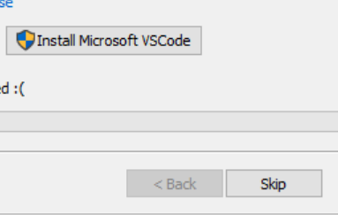
Installation of Python
4. Open the file and follow the prompts to install.
Note: if you need admin privileges talk to this guy
(you shouldn’t need them though)
5. If it asks you to Install Microsoft VSCode, click SKIP
6. For more instructions visit: Detailed Instructions

Slide 4
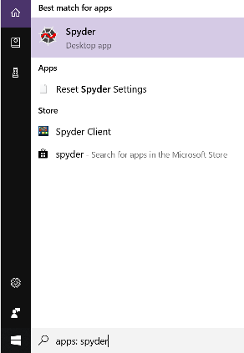
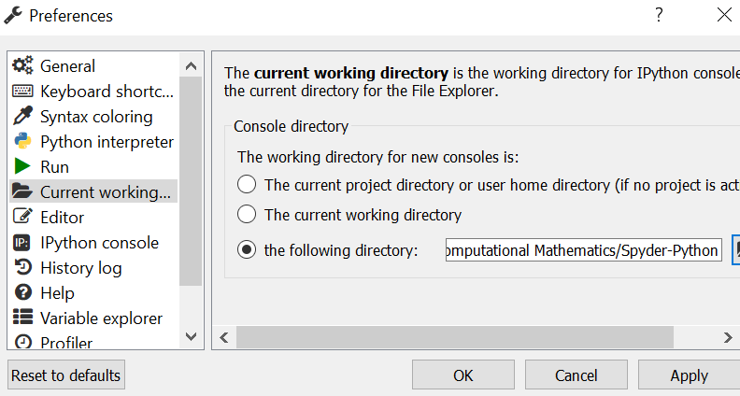
Configuring Spyder
1. Open Spyder
2. Go to
Tools → Preferences →
Current Working Directory
Pick your favorite directory (or make one for this class)
Pick your favorite directory and click Apply

Slide 5
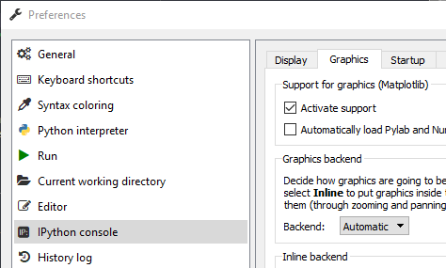
Configuring Spyder (Optional)
1. Open Spyder
2. Go to
Tools → Preferences →
IPython console
3. Change Graphics Backend to Automatic

Slide 6
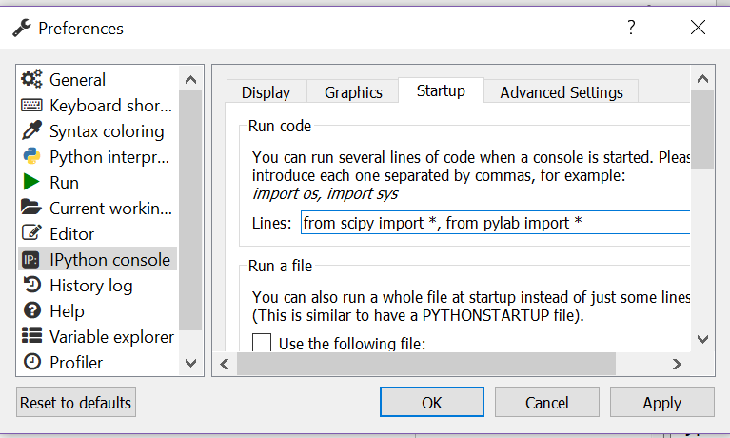
Configuring Spyder
4. Go to: Tools → Preferences → IPython console → Startup
Select Edit templates for new Modules
Change it to
this:
Click Apply
and OK.

Slide 7
Running Your 1st Program
1. Go to the menu item File → New File
2. Add the following line to the file:
print("Hello Python!“)
3. Go to the menu item File → Save
Name your file: hello.py
4. Go to menu item Run → Run or click the green arrow
Congratulations, you are ready to use Python!

